Slide 1
Artificial Neural Network-Based Robotic Control
Master’s Thesis
Justin Ng
June 8, 2018
Committee Chair Committee Member Committee Member | Andrew Danowitz, Ph.D. Xiao-Hua Yu, Ph.D. Fred W. DePiero, Ph.D.

Slide 2
Outline
Outline
Teaser
Introduction/Motivation
Background
Solution
Implementation
Results
Future work and conclusions

Slide 3
Outline
Outline
Teaser
Introduction/Motivation
Background
Solution
Implementation
Results
Future work and conclusions

Slide 4
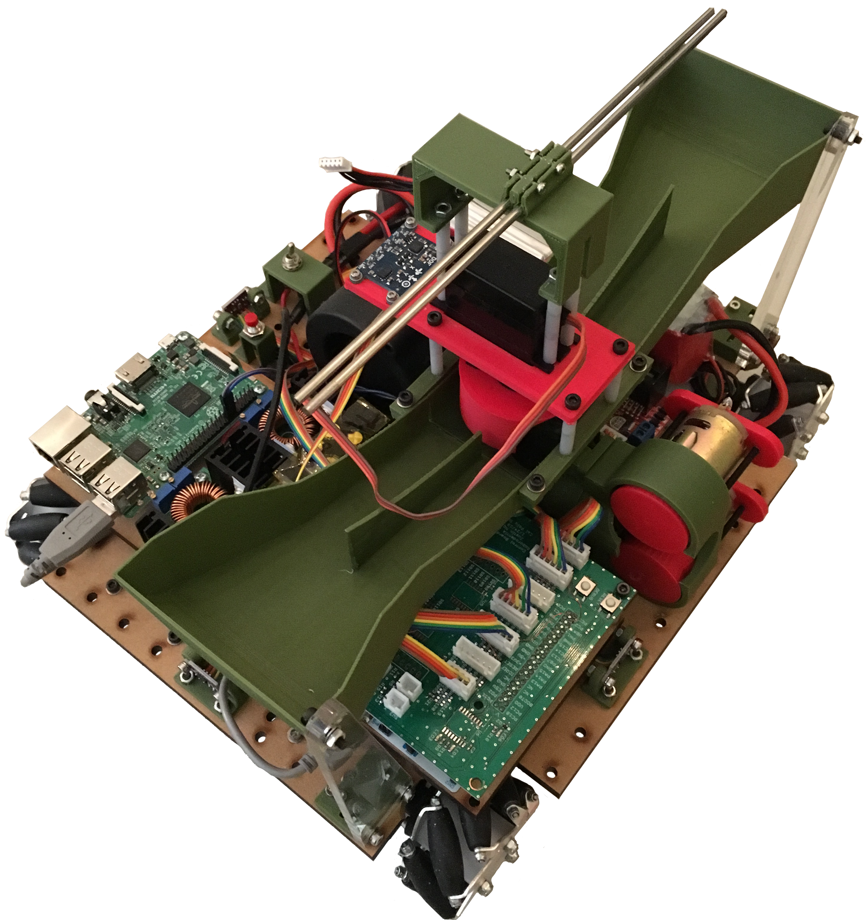
Teaser
Reinforcement learning applied to continuously-controlled robotics.
Controller sets robot’s position and orientation in the environment.

Slide 5
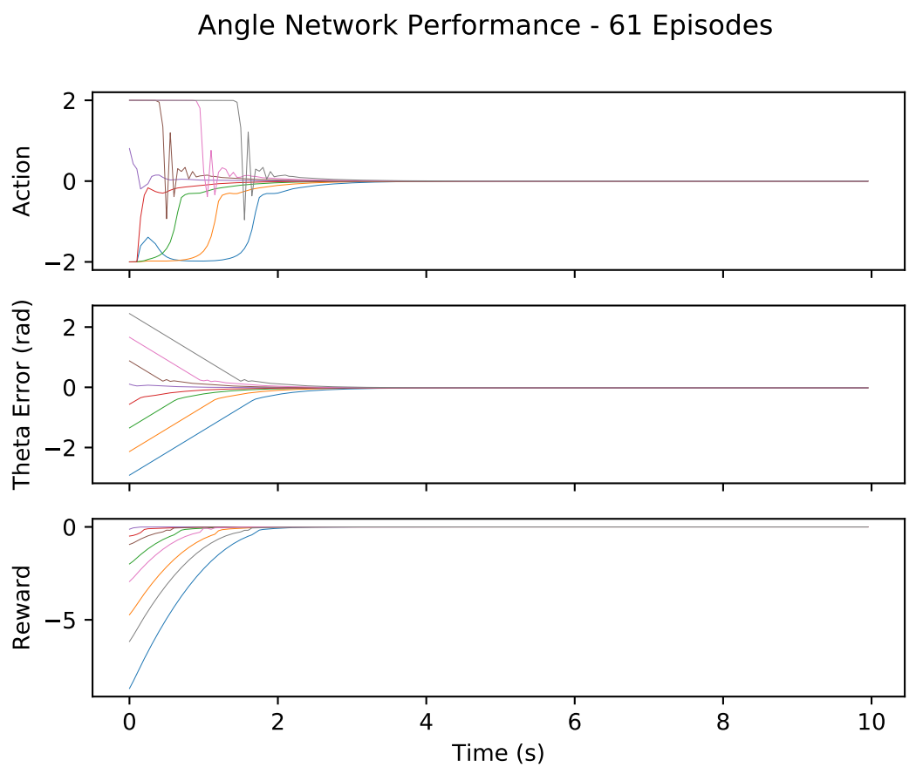
Teaser
Uses deep deterministic policy gradients method developed by DeepMind.
Model-free, actor-critic algorithm implemented with artificial neural networks.

Slide 6
Outline
Outline
Teaser
Introduction/Motivation
Background
Solution
Implementation
Results
Future work and conclusions

Slide 7

Cal Poly Roborodentia
Annual intramural robotics competition.
Fully autonomous robots.
Different game every year.
Source: http://roborodentia.calpoly.edu/
Notes:
Introduce Roborodentia.

Slide 8
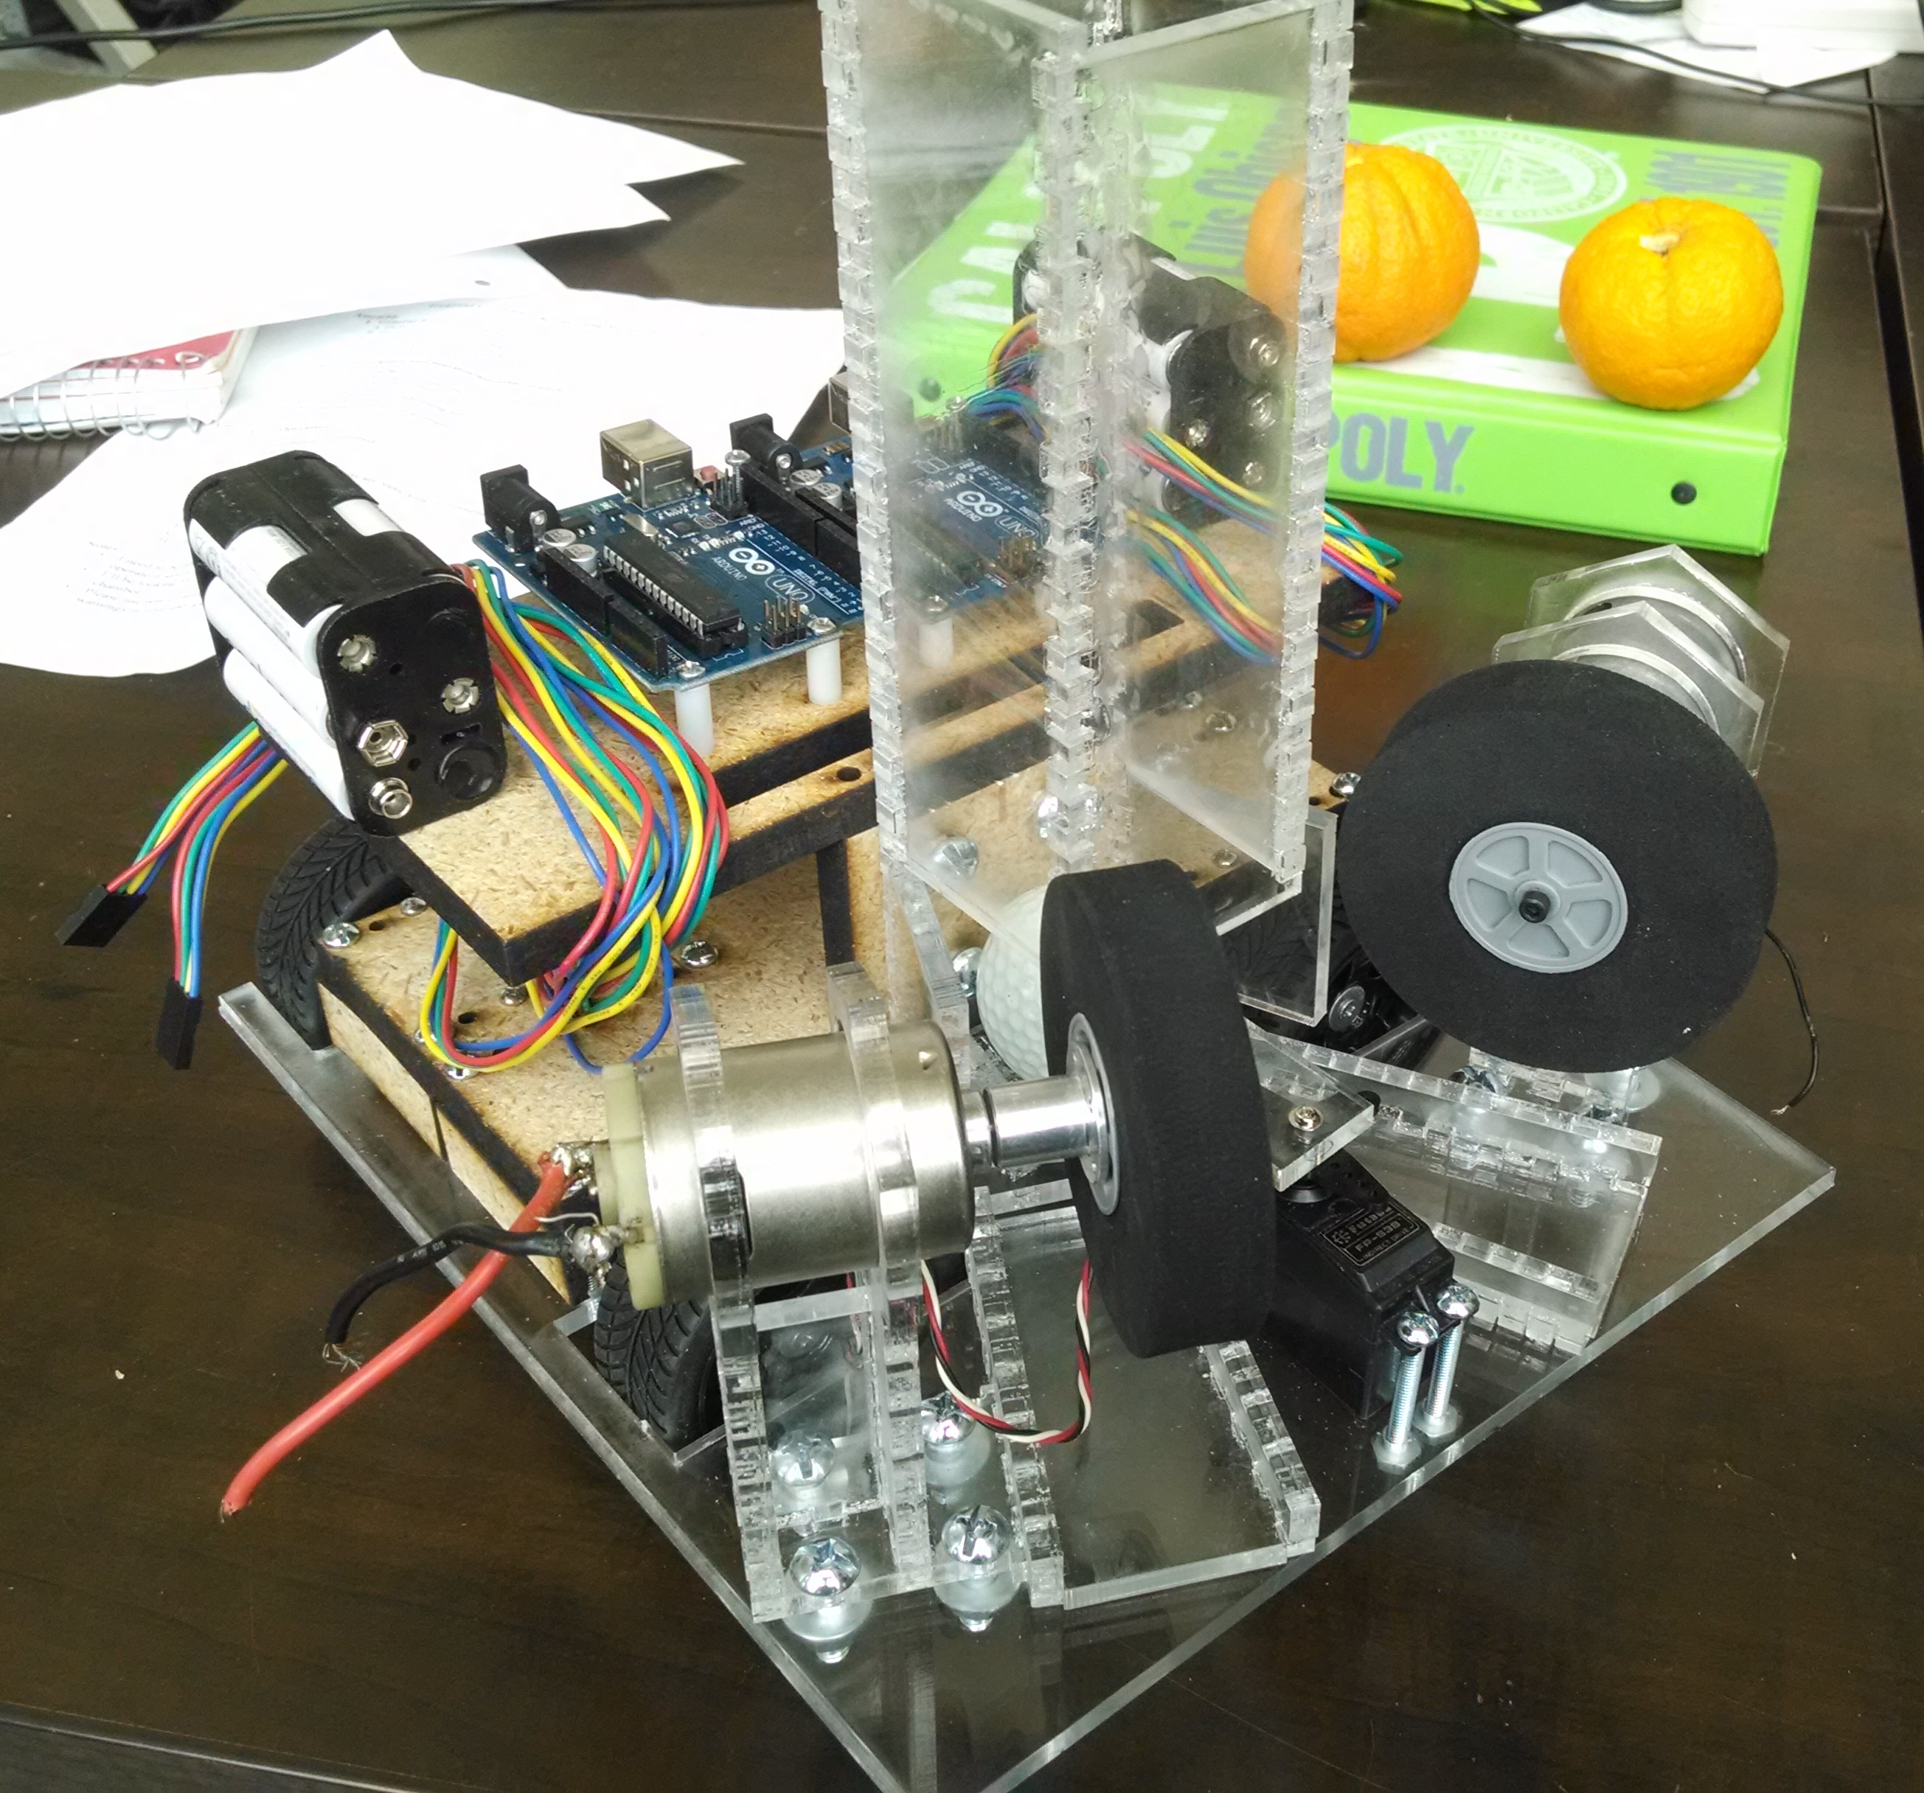
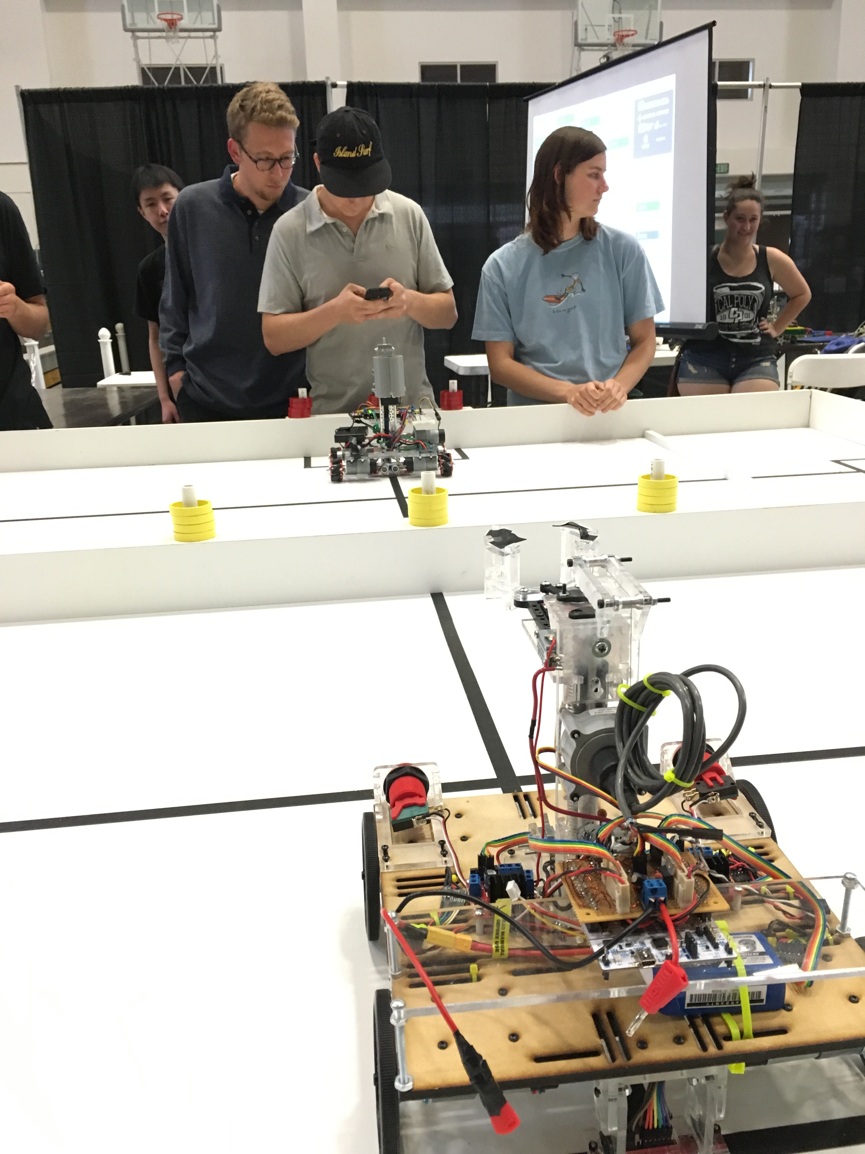
Previous Roborodentia Entries

Slide 9
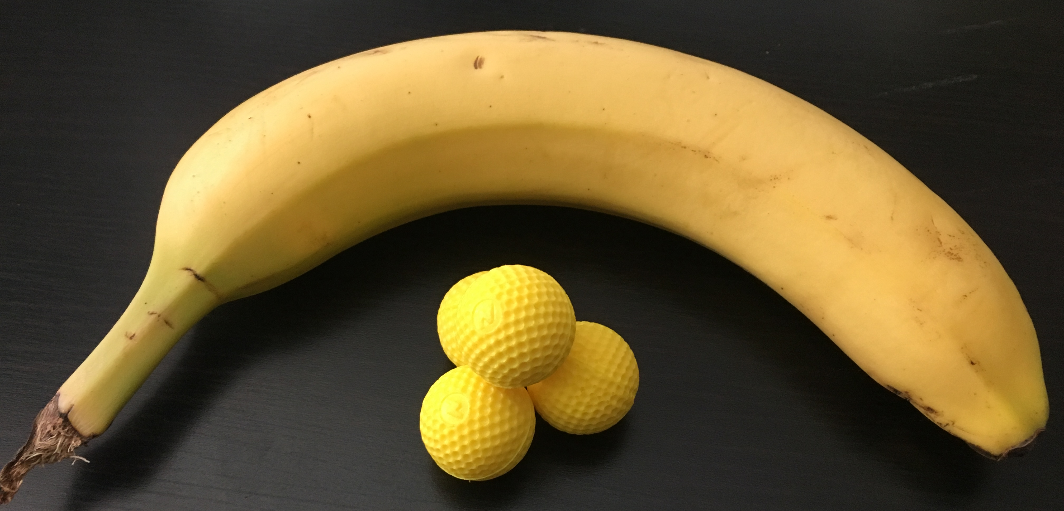
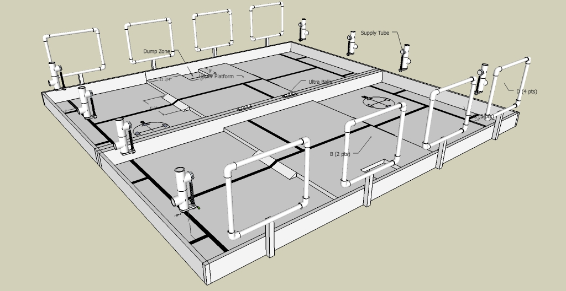
2018 Cal Poly Roborodentia
Robots obtain Nerf Rival balls from supply tubes.
Shoot balls into nets to score points.
Source: http://roborodentia.calpoly.edu/
Notes:
Introduce Roborodentia.

Slide 10
2018 Entry
Built from scratch.
Contains numerous custom parts and electronics.

Slide 11
Outline
Outline
Teaser
Introduction/Motivation
Background
Solution
Implementation
Results
Future work and conclusions

Slide 12
Reinforcement Learning
RL:
Subset of machine learning.
Solves control and action selection problems
“In-between” supervised and unsupervised learning.
Supervised learning: perform classification
Unsupervised learning: data clustering, find underlying patterns.

Slide 13
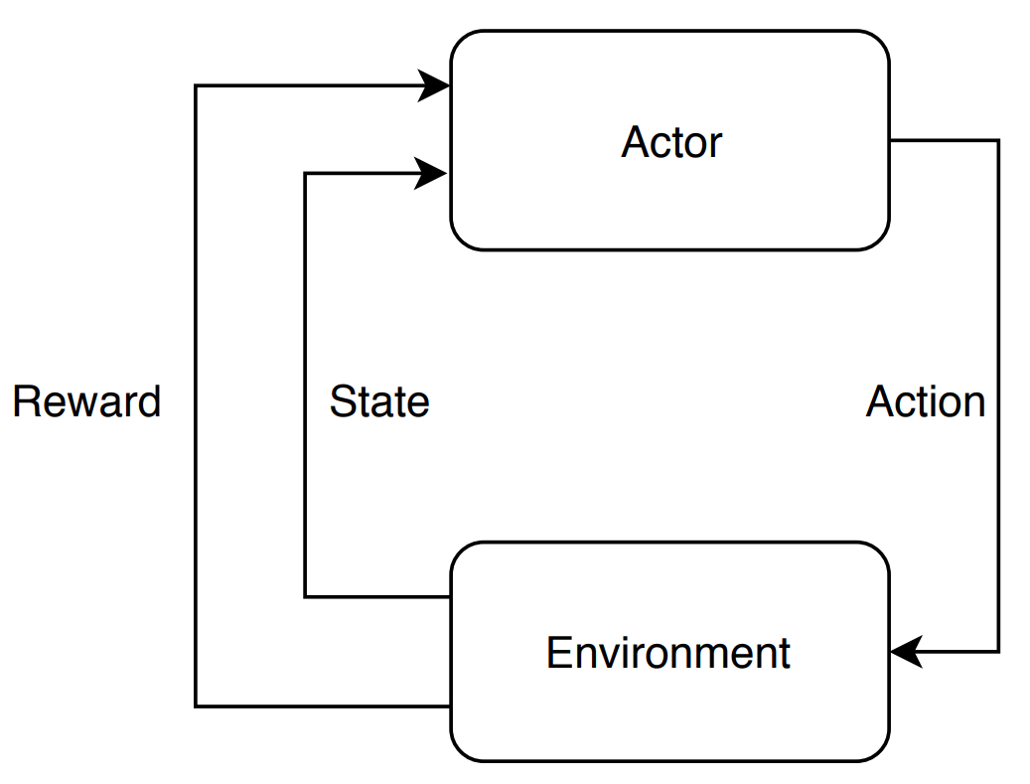
Reinforcement Learning Elements
Environment
Actor/agent
Reward/return (R, r)
Policy (π)
Value function (V, Q)
Sometimes a model
Notes:
Environment The various states and associated rewards through which the actor navigates.
Actor/Agent Chooses actions based on a policy.
Reward/return (r) A number emitted by the environment denoting ”goodness” of the state
Policy (π) The strategy by which the actor chooses its actions, e.g. random, exploratory, greedy.
Value (V) The expected long-term discounted reward of a state.
Model allowing prediction of the next state from the current state and action

Slide 14
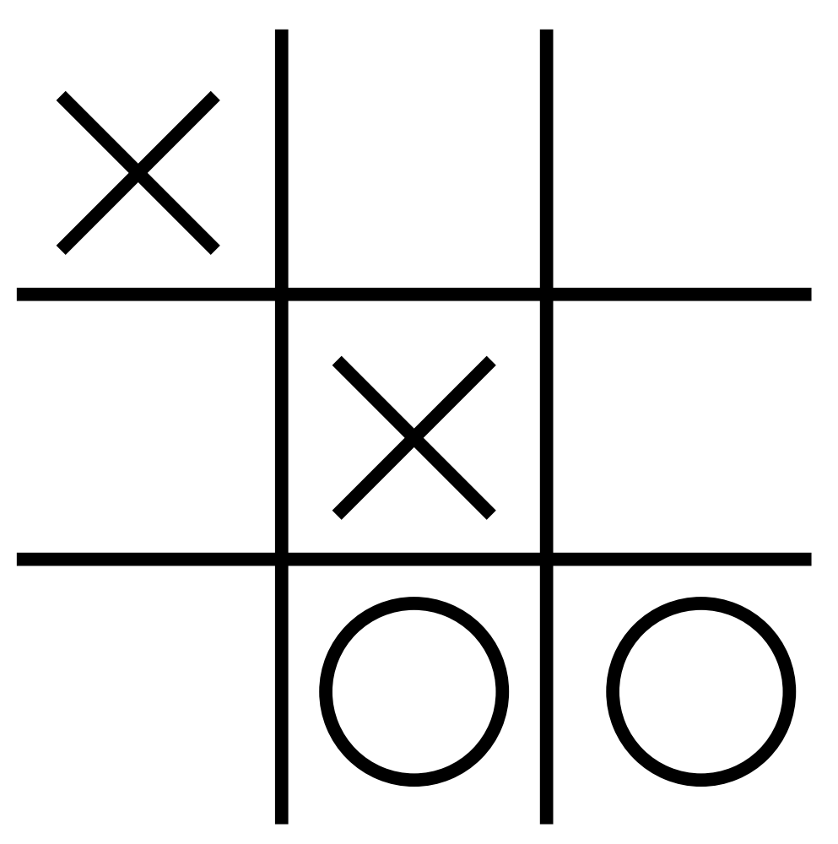
Reinforcement Learning Elements – Tic Tac Toe Example
Environment
Actor
Action (a_{k})
Reward (r_{k})
State (s_{k})
Transition [s_{k}, a_{k}, r_{k}, s_{k+1}]

Slide 15
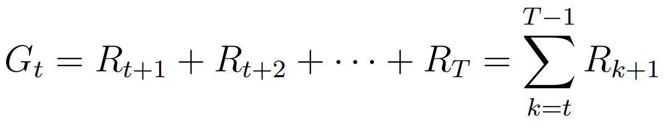
Long-term reward G_{t}
Calculated as sum of all future rewards.
Usable in RL problems with a definitive end.
Actor’s goal to maximize G_{t}.

Slide 16
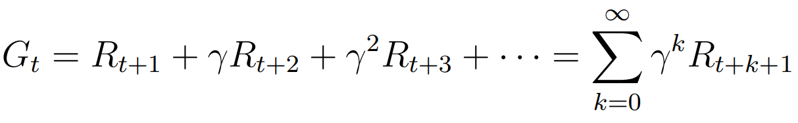
Long-term discounted reward G_{t}
Calculated as sum of all future rewards weighted by a discount factor γ.
Allows G_{t} to converge for environments with no maximum time step.
Sets algorithm’s “outlook” from myopic to far-sighted.
Notes:
Gamma ranges from 0 to 1
1 is

Slide 17

Value Functions
Indicates the long-term reward expected from a state.
Even if a state only has a small immediate reward, it may possess high value since it leads to high reward states.
Source: https://arcdigital.media/the-trans-pacific-partnership-
a-pawn-sacrifice-in-a-global-game-22e62cdf775
Notes:
Imagine a game of chess. Sacrificing a piece may seem like a negative action but may open other opportunities.

Slide 18
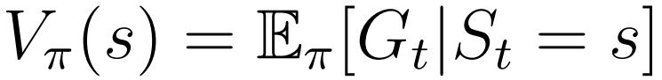
Value Functions
Expected long-term reward as a function of the state under a certain policy π.
Notes:
For the game of tic tac toe, there are values for each of 19,683 states.

Slide 19
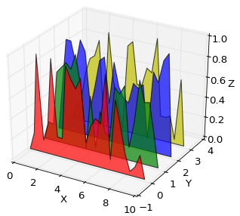

Q-Functions
Expected long-term reward as a function of the state and action under a certain policy π.
Represents the quality of an action in a particular state.
Source: https://matplotlib.org/1.3.0/mpl_examples
/mplot3d/polys3d_demo.png
Notes:
For the game of tic tac toe, there are values for each of 19,683 states.

Slide 20
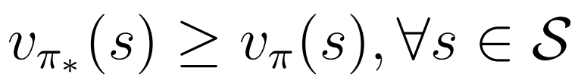
Policies
Optimal (π∗): produces greater value for every possible state than any other policy (π).
Greedy: take action with highest value/Q-value.
Random: pick a random action.
ε-greedy: pick greedy action with probability 1- ε and random action with probability ε.

Slide 21
RL Algorithms
Q-Learning
SARSA
DQN
PG
DPG
DDPG

Slide 22
Outline
Outline
Teaser
Introduction/Motivation
Background
Solution
Implementation
Results
Future work and conclusions

Slide 23
Outline
Outline
Teaser
Introduction/Motivation
Background
Solution
Implementation
Results
Future work and conclusions

Slide 24
Outline
Outline
Teaser
Introduction/Motivation
Background
Solution
Implementation
Results
Future work and conclusions

Slide 25
Outline
Outline
Teaser
Introduction/Motivation
Background
Solution
Implementation
Results
Future work and conclusions

